Slide 1
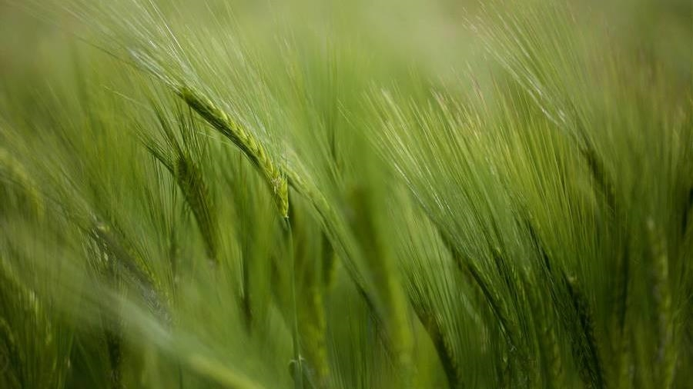
CROP YIELD PREDICTION
BY-ADITYA JADHAV
​​

Slide 2

Objective TO STUDY
The objective of our study is to provide a solution for Smart Agriculture by monitoring the agriculture filed which can assist the farmers in increasing productivity to a great extent.
The proposed system filed which can assist machine learning and prediction algorithm like Linear Regression to identify pattern among data and then process it as per input conditions.

Slide 3
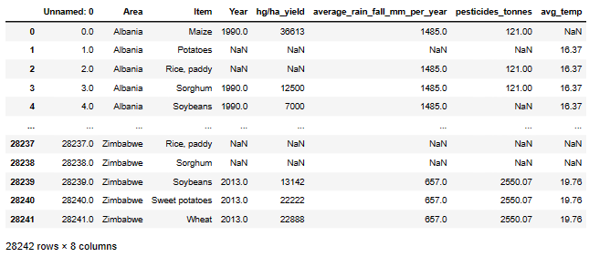
DATA SET DETAILS
We have collected the data set for the crop prediction for real world scenario data is available in git hub.com this data set contains attributes such as Rain fall , Pesticides , item , Area ,temp , year , yield etc.

Slide 4
Exploratory Data Analysis - EDA
Exploratory Data Analysis (EDA) is an essential step in the machine learning process, including when building a crop yield prediction model using linear regression.
EDA helps you understand your dataset, identify patterns, outliers, and relationships between variables.
EDA is applied to investigate the data and summarize the key insights. It will give you the basic understanding of your data.

Slide 5
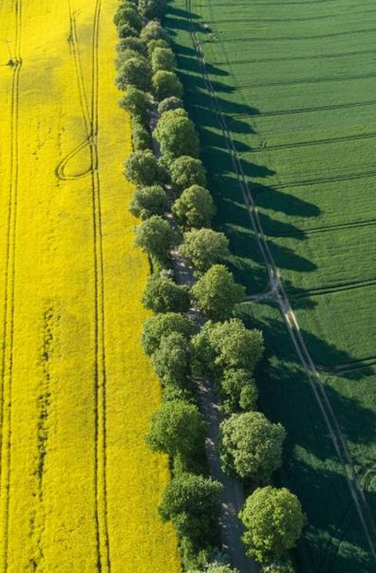
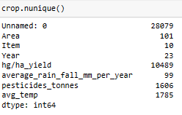
Unique values in data

Slide 6
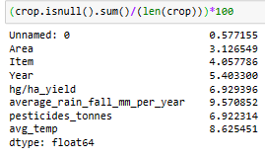
PERCENTAGE MISSING VALUES in data

Slide 7

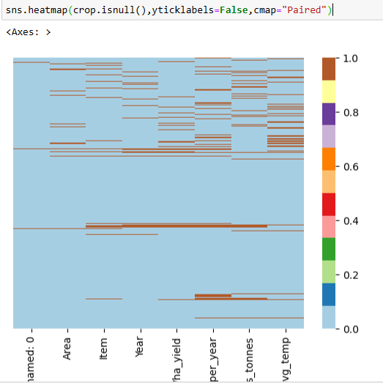




Heatmap of missing values in data
Unique
First to market
Tested
Authentic
Only product specifically dedicated to the agricultural market
First beautifully designed product that's both stylish and functional
Conducted testing with young farmers in the area
Designed with the help and input of agricultural experts in the field

Slide 8
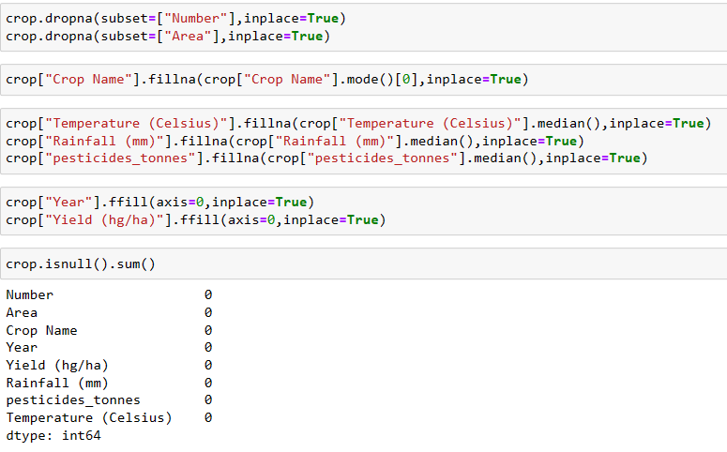
TREATMENT of missing values
Unique
First to market
Tested
Authentic
Only product specifically dedicated to the agricultural market
First beautifully designed product that's both stylish and functional
Conducted testing with young farmers in the area
Designed with the help and input of agricultural experts in the field

Slide 9
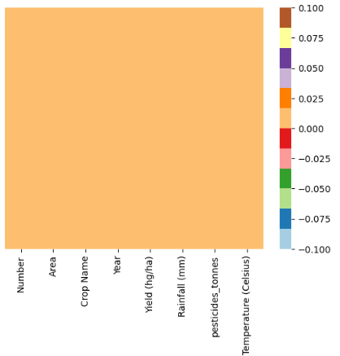
Heatmap of ZERO missing values
First to market
Only product specifically dedicated to the agricultural market
Tested
Unique
Designed with the help and input of agricultural experts in the field
First beautifully designed product that's both stylish and functional
Authentic
Conducted testing with young farmers in the area

Slide 10

DATA VISUALIZATION

Slide 11
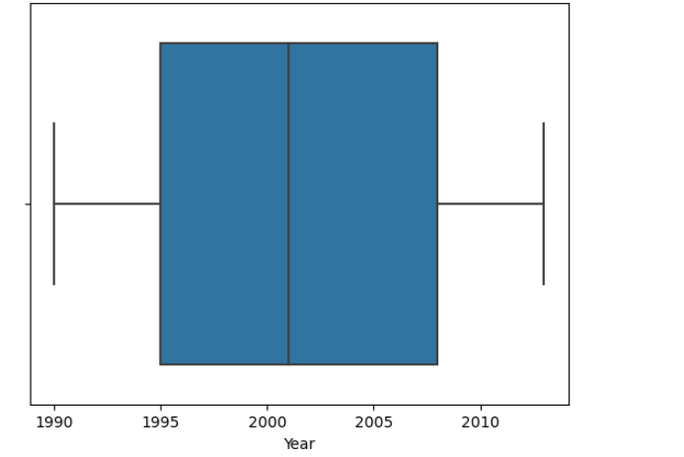
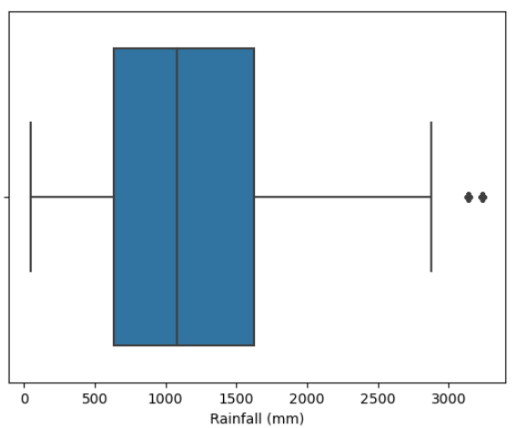
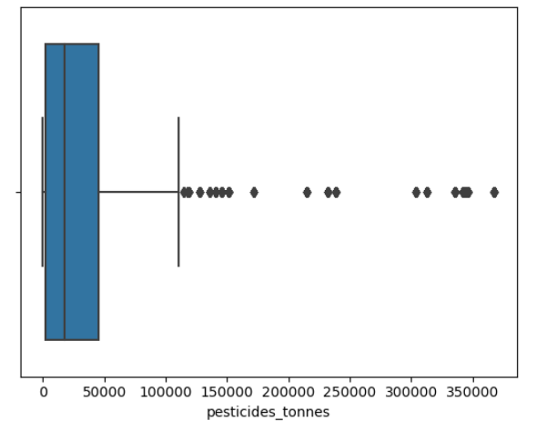
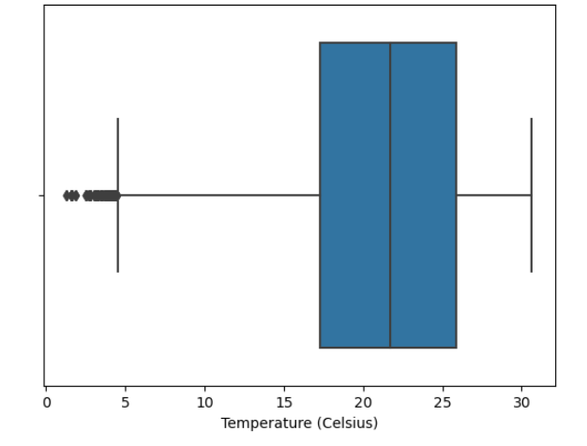
BOX PLOTS
Unique
First to market
Tested
Authentic
Only product specifically dedicated to the agricultural market
First beautifully designed product that's both stylish and functional
Conducted testing with young farmers in the area
Designed with the help and input of agricultural experts in the field

Slide 12
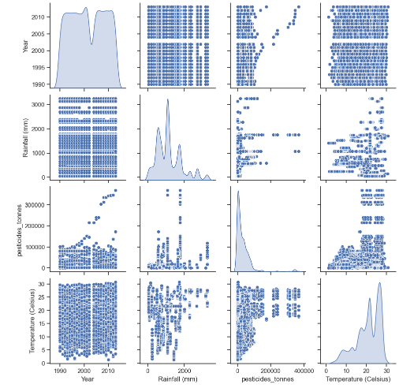
PAIR PLOTS
Unique
First to market
Tested
Authentic
Only product specifically dedicated to the agricultural market
First beautifully designed product that's both stylish and functional
Conducted testing with young farmers in the area
Designed with the help and input of agricultural experts in the field

Slide 13
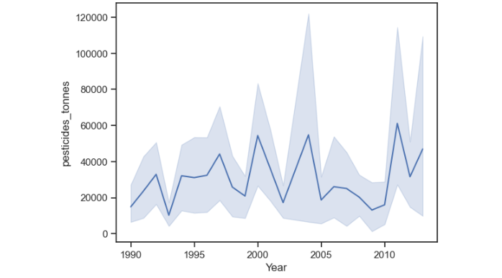
DATA VISUALIZATION
Line plot show how many tonnes of pesticides use in specific year

Slide 14
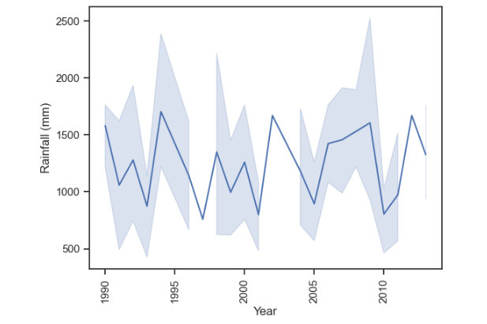
DATA VISUALIZATION
It show average rainfall in previous year

Slide 15
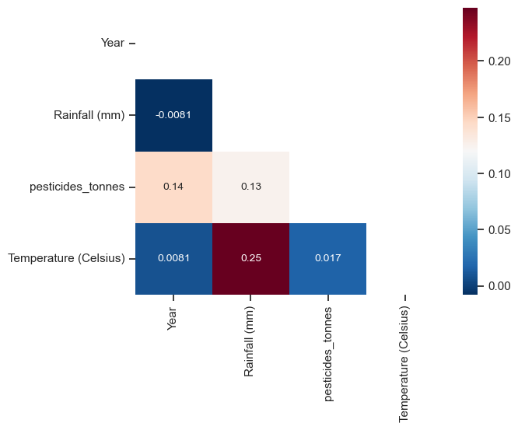
DATA VISUALIZATION
Heatmap of correlation between columns

Slide 16
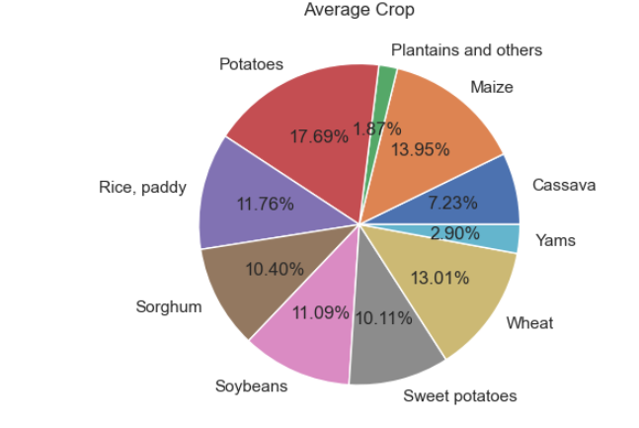
DATA VISUALIZATION
Which crop has the highest production ?

Slide 17
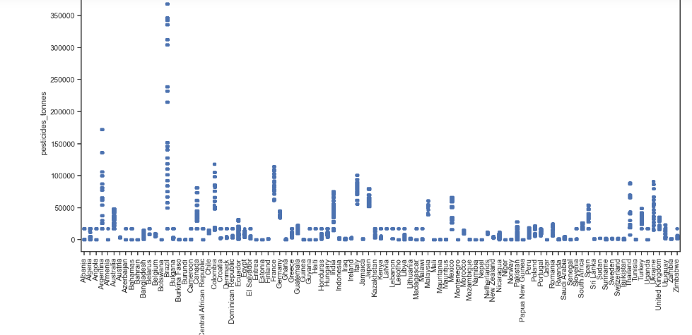
DATA VISUALIZATION
Which country use more pesticides ?

Slide 18
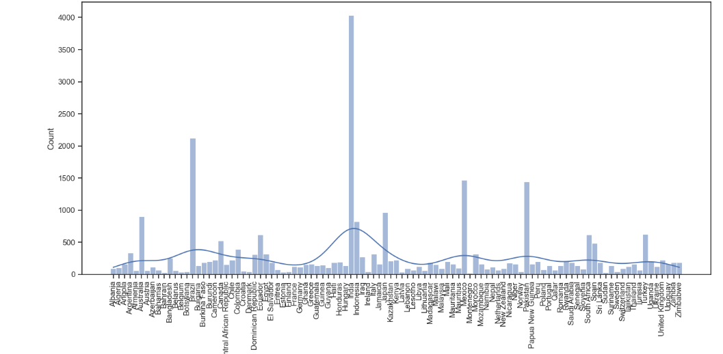
DATA VISUALIZATION
Which country has the highest production of crops?

Slide 19
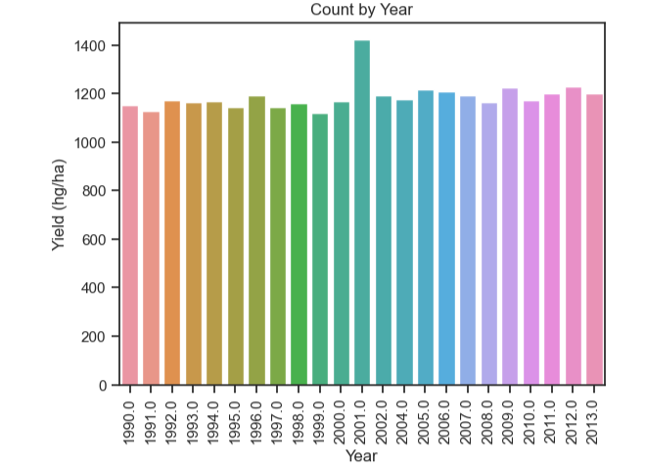
DATA VISUALIZATION
A box plot shows yield count by year.

Slide 20
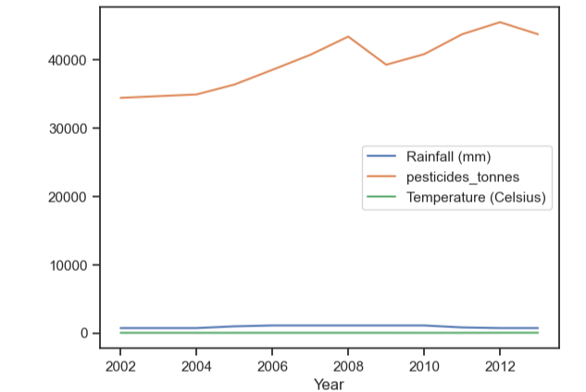
DATA VISUALIZATION
KDE PLOT FOR GERMANY

Slide 21
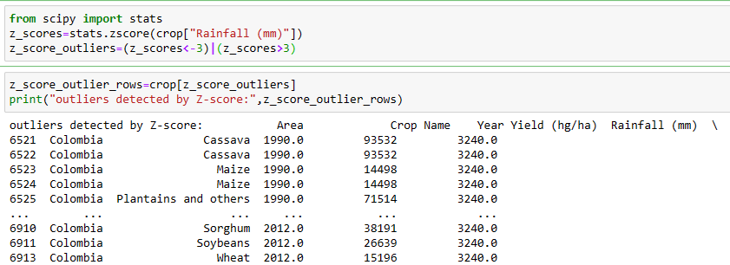
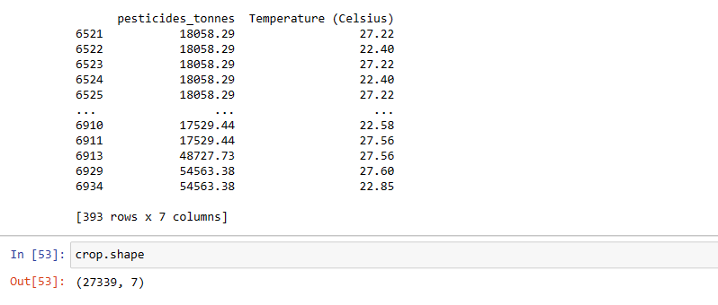
Outlier Detection and RemovaL.
Unique
First to market
Tested
Authentic
Only product specifically dedicated to the agricultural market
First beautifully designed product that's both stylish and functional
Conducted testing with young farmers in the area
Designed with the help and input of agricultural experts in the field

Slide 22
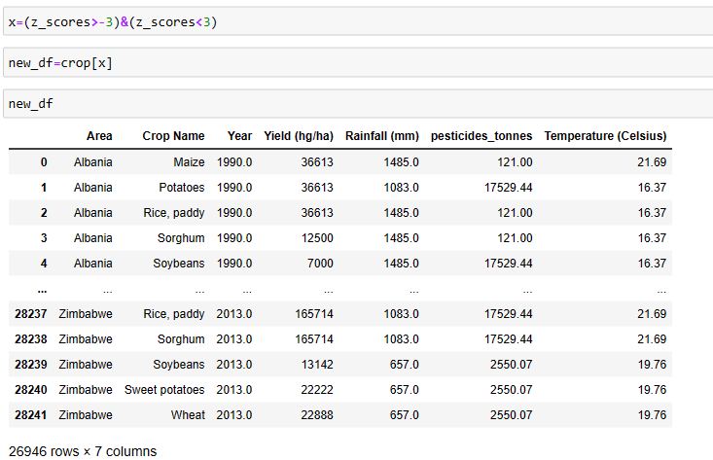
Unique
First to market
Tested
Authentic
Only product specifically dedicated to the agricultural market
First beautifully designed product that's both stylish and functional
Conducted testing with young farmers in the area
Designed with the help and input of agricultural experts in the field

Slide 23
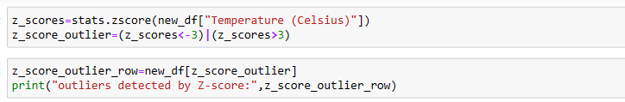
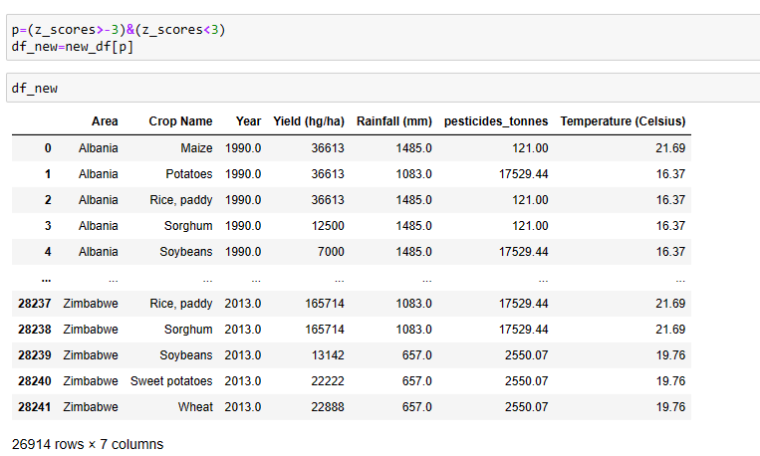
Unique
First to market
Tested
Authentic
Only product specifically dedicated to the agricultural market
First beautifully designed product that's both stylish and functional
Conducted testing with young farmers in the area
Designed with the help and input of agricultural experts in the field

Slide 24
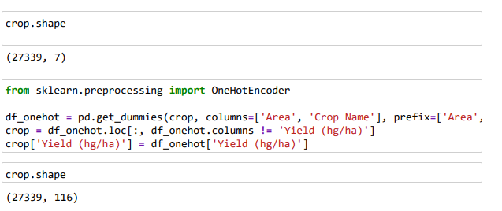
One Hot Encoding
Unique
First to market
Tested
Authentic
Only product specifically dedicated to the agricultural market
First beautifully designed product that's both stylish and functional
Conducted testing with young farmers in the area
Designed with the help and input of agricultural experts in the field

Slide 25
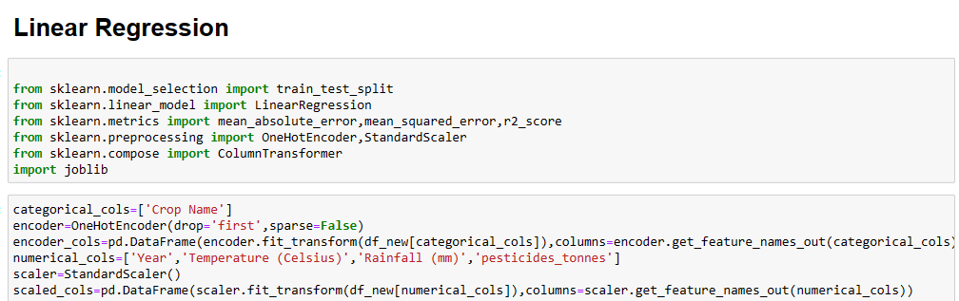
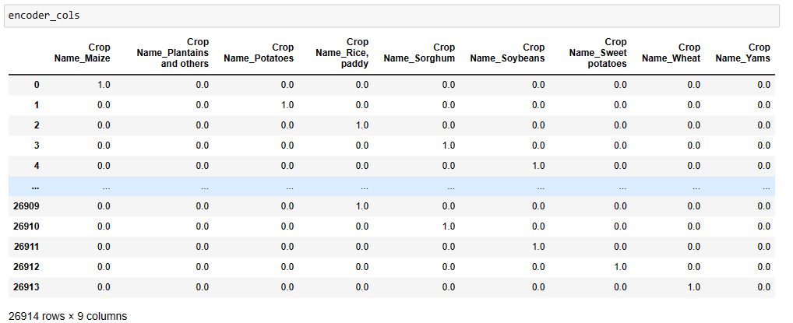
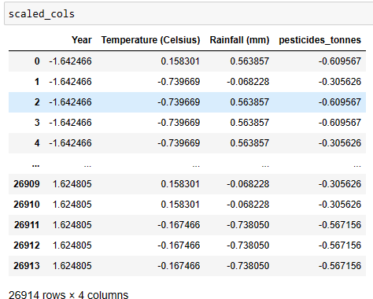
Unique
First to market
Tested
Authentic
Only product specifically dedicated to the agricultural market
First beautifully designed product that's both stylish and functional
Conducted testing with young farmers in the area
Designed with the help and input of agricultural experts in the field

Slide 26
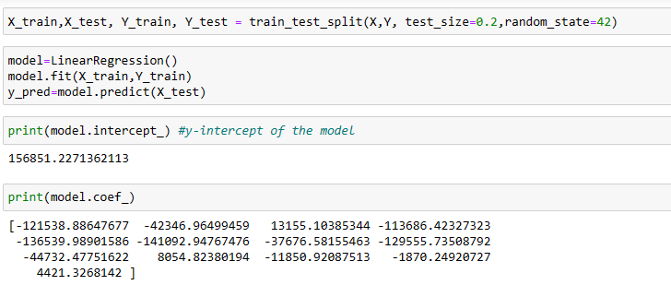
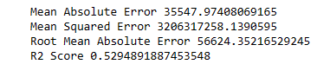
Unique
First to market
Tested
Authentic
Conducted testing with young farmers in the area
Designed with the help and input of agricultural experts in the field
Mean Absolute Error=
Mean Squared Error=
Root Mean Absolute Error=
R2 Score=

Slide 27
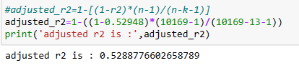
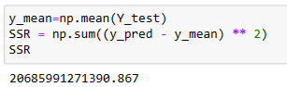
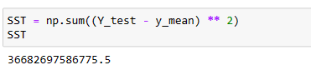
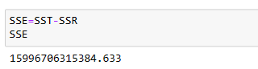
Adjusted r2
sum of squares regression (SSR)
sum of squares total (SST)
sum of squares error (SSE)
Only product specifically dedicated to the agricultural market
Conducted testing with young farmers in the area
Authentic
Designed with the help and input of agricultural experts in the field
First to market
First beautifully designed product that's both stylish and functional
Unique

Slide 28
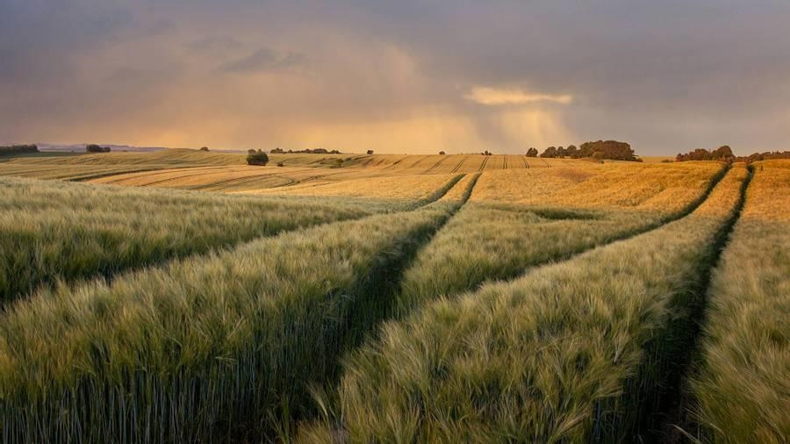
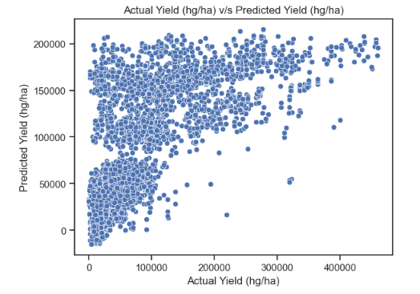
ACtual Yield (hg/ha) v/s Predicted Yield (hg/ha)

Slide 29
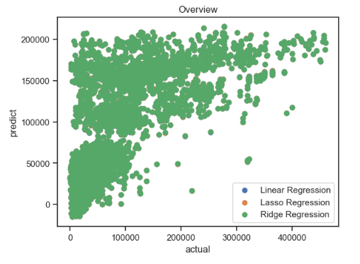
OVERVIEW

Slide 30
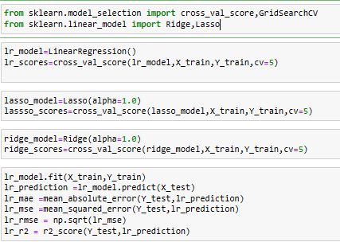
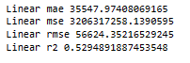
L1 (LASSO) & L2(Ridge)

Slide 31
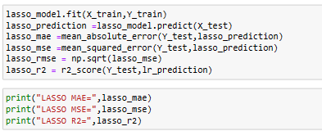
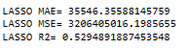
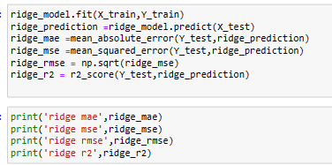
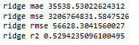
L1 (LASSO) & L2(Ridge)

Slide 32

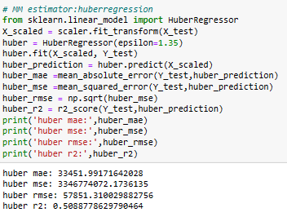
ROBUST TECHNIQUE MM ESTIMATOR (huber regression)

Slide 33
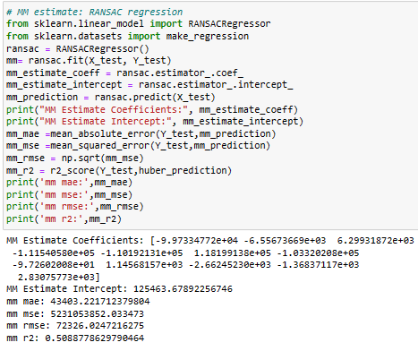
ROBUST TECHNIQUE MM ESTIMATOR (RANSAC regression)

Slide 34
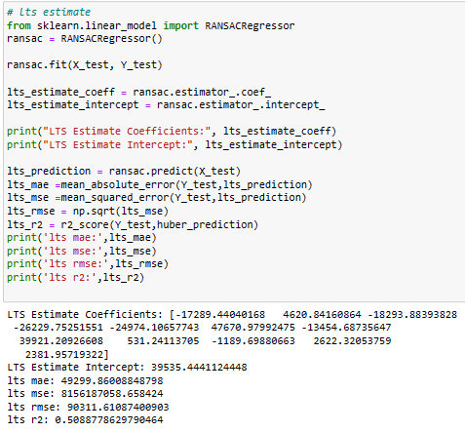
ROBUST TECHNIQUE MM ESTIMATOR (LTS regression)

Slide 35
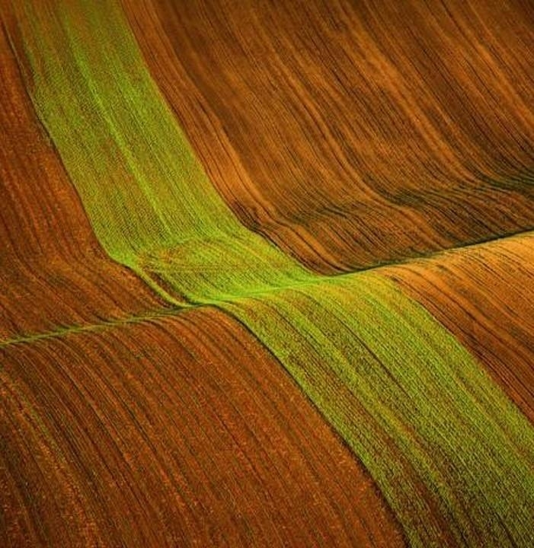
Thank you

